Slide 1
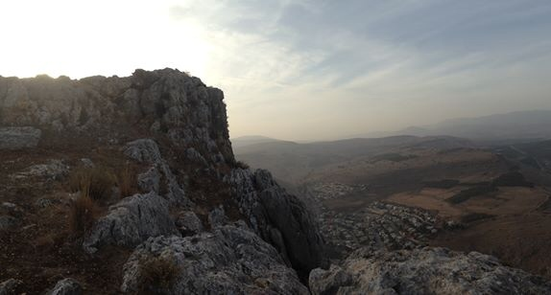
Praying Friends of the Bridegroom (PFOTBG)
“He who has the bride is the bridegroom;
but the friend of the bridegroom, who stands and hears him, rejoices greatly
because of the bridegroom’s voice.
So this joy of mine has been made full.”
John 3:29
Mt. Arbel, Israel

Slide 2
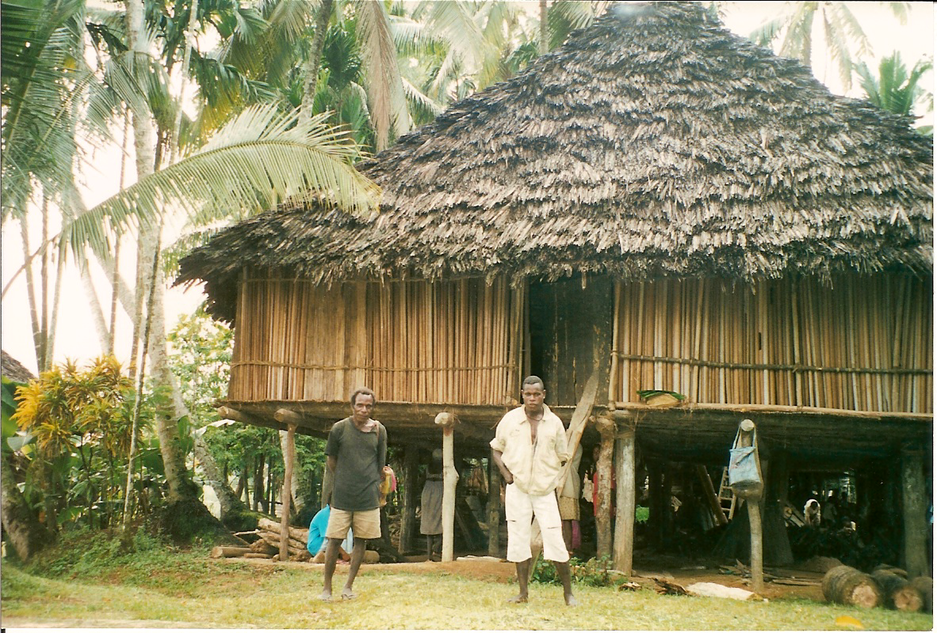
The Beginning of
PFOTBG
PNG – one of the homes in Hauna Village
In 1999 the Lord gave the idea for PFOTBG in a dream while I (M.J. Arant) was helping a medical team in Papua New Guinea. At night we were surrounded by mosquito nets in the mission house where we stayed in the middle of the jungle on the Sepic River. One night God gave me the dream about being a friend of the bridegroom.

Slide 3
That night I dreamed I was in England on a mission trip in a very formal garden with a formal clock… just opposite of the surroundings in the jungle. While we prayed with people and shared about Jesus in this garden, the clock began to chime hours and not designate minutes…1 o’clock, 2 o’clock, 3 o’clock. All of us stopped what we were doing in the garden and looked at the clock. I woke up and said, “Lord if you are trying to tell me something will you please tell me what it is?” In my spirit I felt like He said, “It is time to be a friend of the bridegroom.” From that night and for about 6 months I prayed, “Lord, please show me how I am not Your friend and how You want me to be Your friend.”
Praying at a clock
in Tel Aviv, Israel

Slide 4
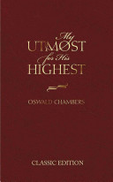
Praying Friends of the Bridegroom (PFOTBG)
At the end of March 2000 I was reading entries in a devotional book, My Utmost for His Highest, that focused on the verse John 3:29. My heart burned as I read this and knew John 3:29 was the verse that went with the dream.
He [Jesus] who has the bride [the church] is the Bridegroom [Jesus]; but the friend of the bridegroom, who stands and hears Him, rejoices greatly because of the Bridegroom's voice. Therefore this joy of mine is fulfilled. John 3:29

Slide 5
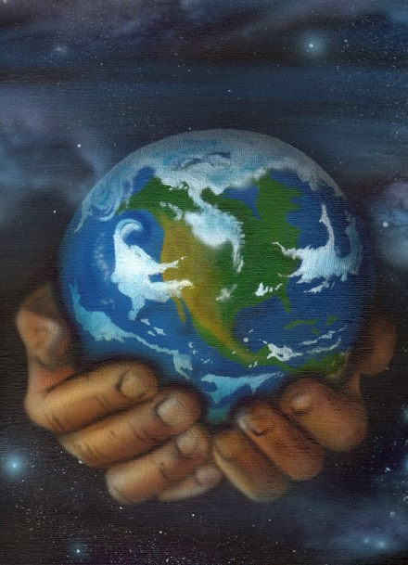
As I read John 3:29 it seemed that God was looking at the earth and His heart was broken that not more incense, i.e. prayers of the saints (believers in Jesus Christ as the Son of God), was coming before His throne. (Revelation 5:8). He laid out the need for more prayer from me along with every person, every people, tribe, and tongue on earth. He wanted me and whoever was led to share the need for increased prayer, to join others who were praying and help to raise prayers to Him at the ends of the earth where little to no prayer was coming forth. I was blown away by this idea and said to the Lord that I couldn’t do this task. He (God) said He knew that, and He would do it.

Slide 6
A group of us began studying the Bible to learn and employ Scriptural prayers and principles of prayer. We continue to meet for prayer times, sharing, teaching, retreats, conferences, and dinners in the USA and other countries. We seek for God to teach us about intercession and desire to join with God’s people in prayer. We ask for the Spirit of God to intercede through us and teach us how to live in communion with God and in peace with all people. We appreciate our brothers and sisters around the world who are interceding for the world, including us.
Now Praying Friends of the Bridegroom is a non-profit organization which is incorporated and has a 501 (c) (3) status.

Slide 7
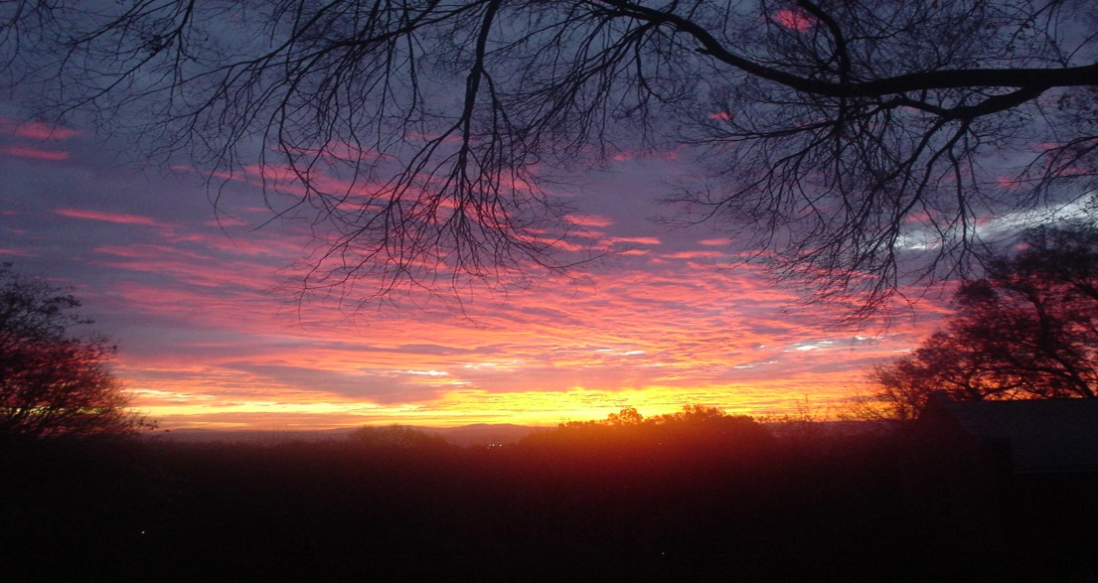
For from Him and
through Him and to Him are all things.
To Him be the glory forever. Amen.
Romans 11:36

